Slide 1
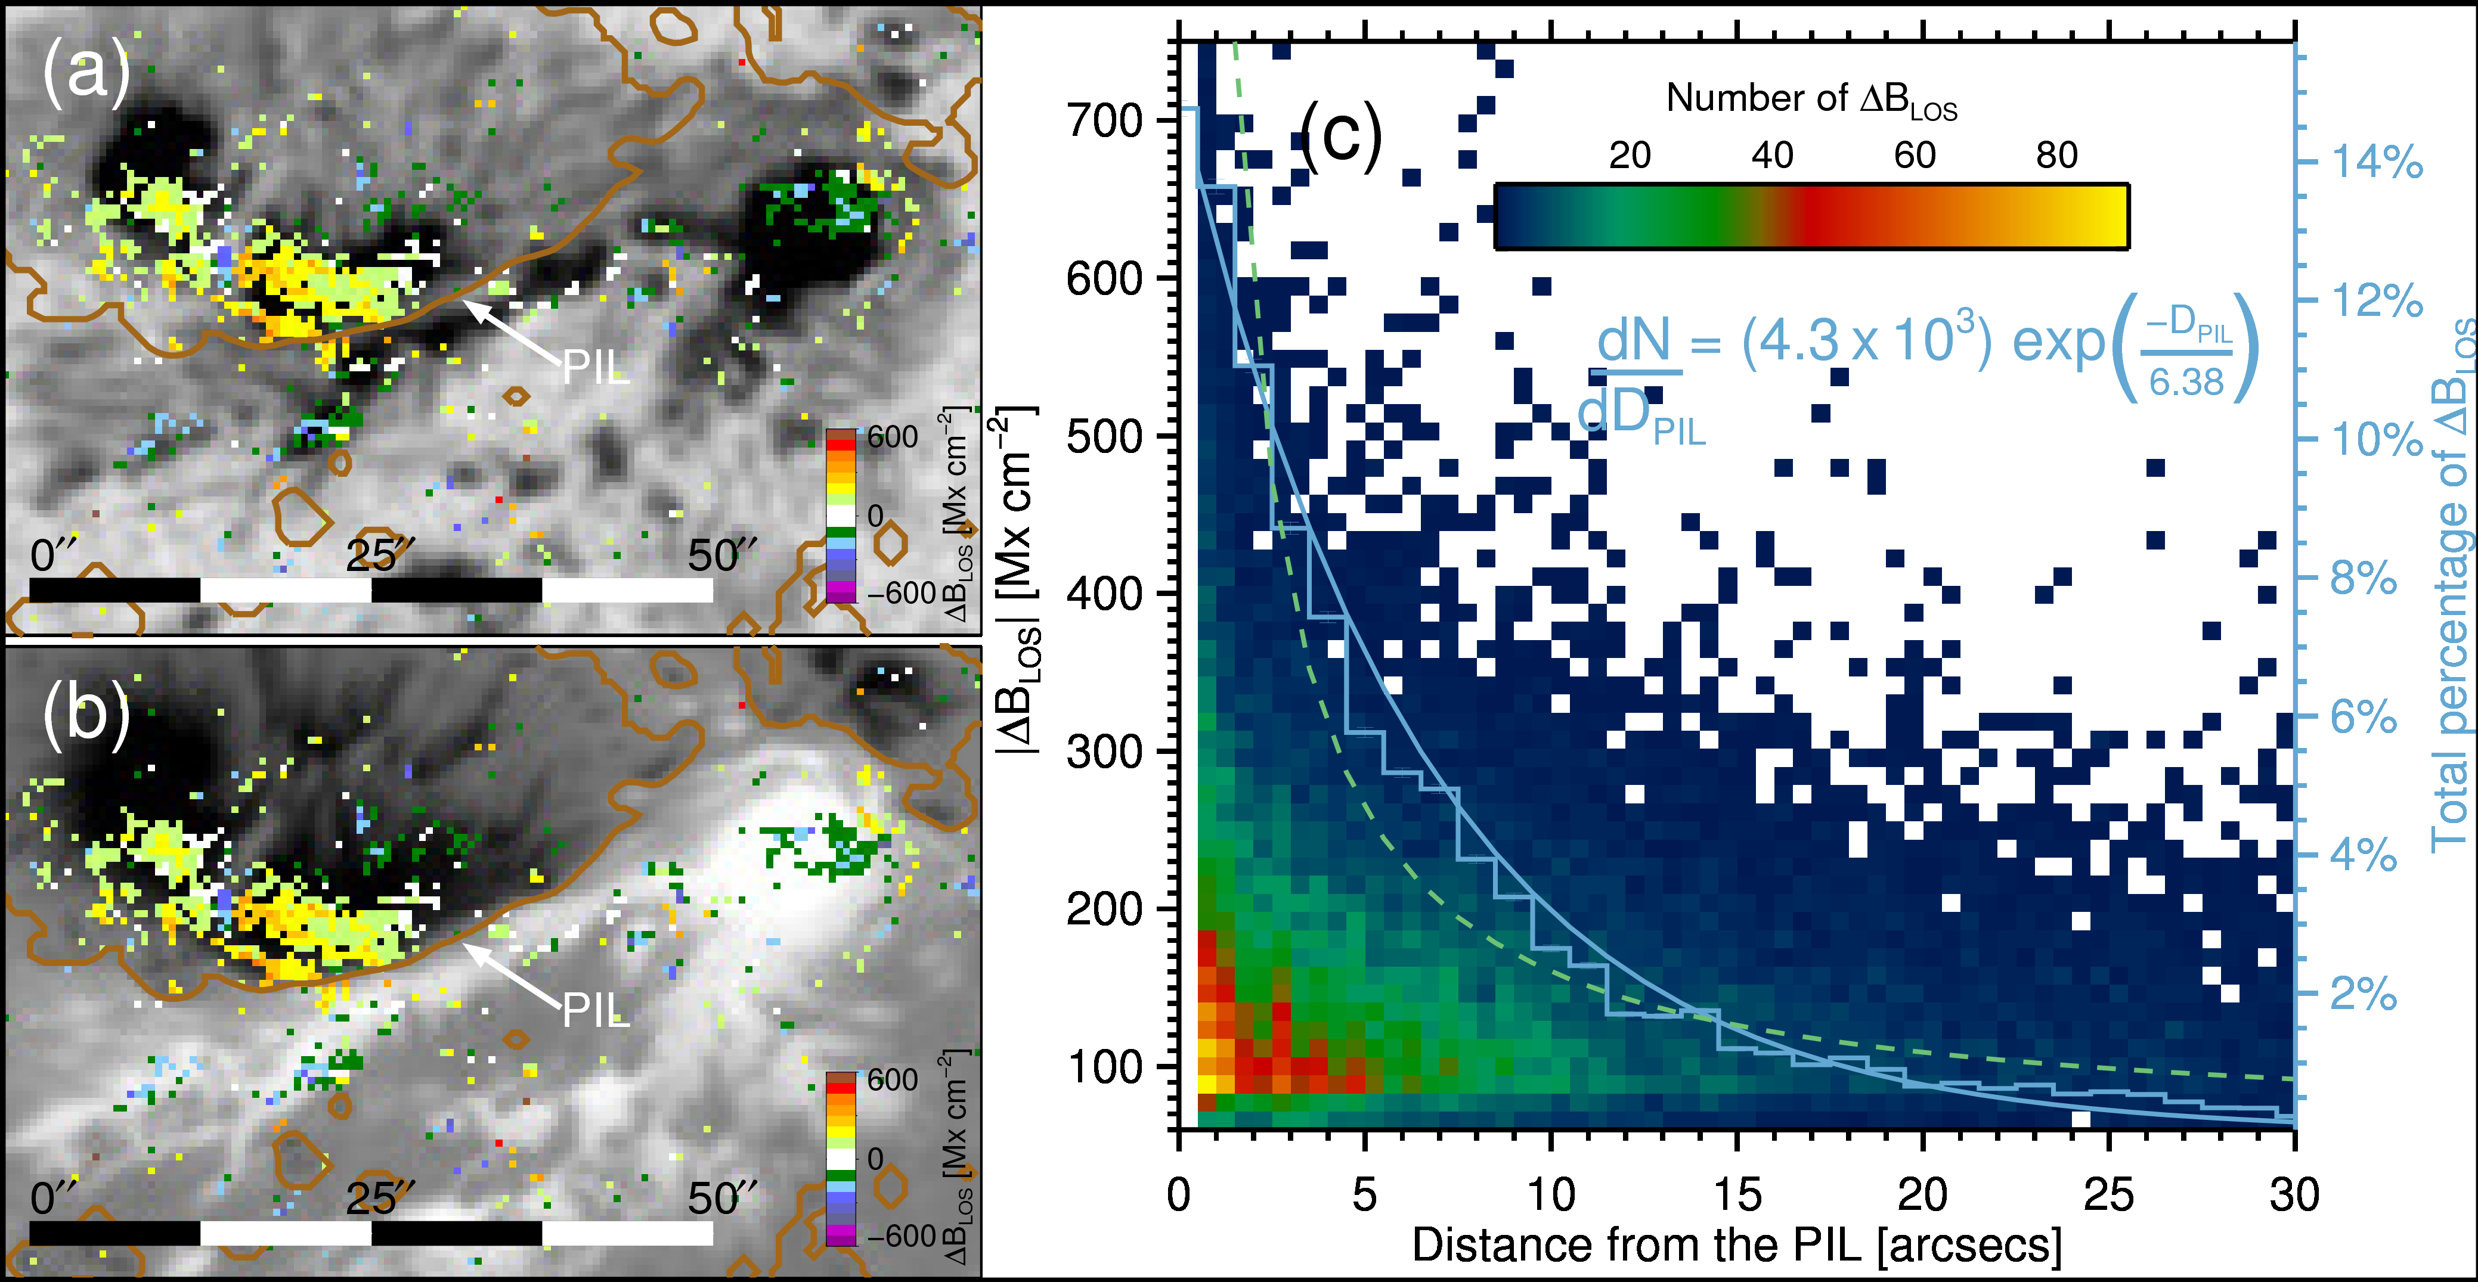

Abrupt and permanent changes of photospheric magnetic fields have been observed during solar flares. The changes seem to be linked to the reconfiguration of magnetic fields, but their origin is still unclear. We carried out a statistical analysis of permanent line-of-sight magnetic field (BLOS) changes during 18 X-, 37 M-, 19 C-, and 1 B-class flares using data from the Solar Dynamics Observatory/Helioseismic and Magnetic Imager. We investigated the properties of permanent changes, such as frequency, areas, and locations. We detected changes of BLOS in 59/75 flares. We find that strong flares are more likely to show changes, with all flares M1.6 exhibiting them. For weaker flares, permanent changes are observed in 6/17 C-flares. 34.3% of the permanent changes occurred in the penumbra and 18.9% in the umbra. Parts of the penumbra appeared or disappeared in 23/75 flares. The area where permanent changes occur is larger for stronger flares. Strong flares also show a larger change of flux, but there is no dependence of the magnetic flux change on the heliocentric angle. The mean rate of change of flare-related magnetic field changes is 20.7 Mx ${cm}^{−2}$min⁻¹. The number of permanent changes decays exponentially with distance from the polarity inversion line. The frequency of the strength of permanent changes decreases exponentially, and permanent changes up to 750 Mx cm⁻² were observed. We conclude that permanent magnetic field changes are a common phenomenon during flares, and future studies will clarify their relation to accelerated electrons, white-light emission, and sunquakes to further investigate their origin.

Slide 2
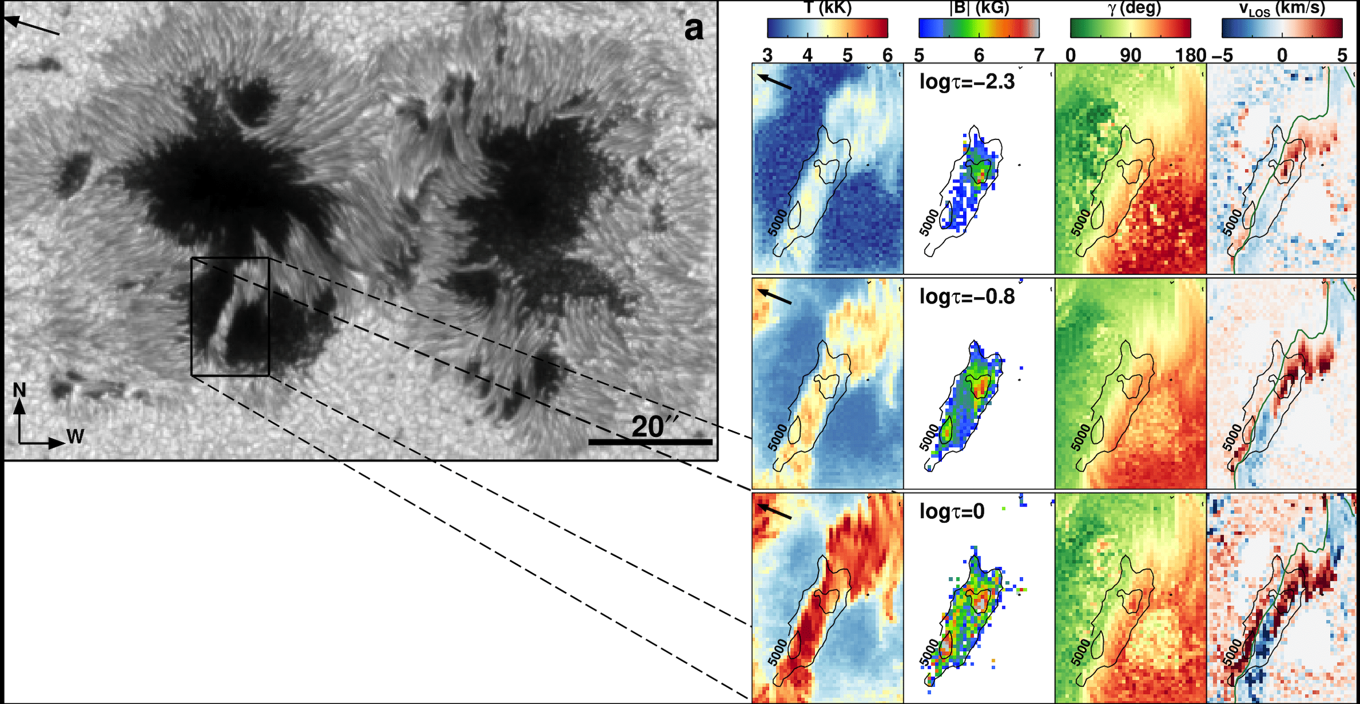
Traditionally, the strongest magnetic fields on the Sun have been measured in sunspot umbrae. More recently, however, much stronger fields have been measured at the ends of penumbral filaments carrying the Evershed and counter-Evershed flows. Superstrong fields have also been reported within a light bridge separating two umbrae of opposite polarities. We aim to accurately determine the strengths of the strongest fields in a light bridge using an advanced inversion technique and to investigate their detailed structure. We analyze observations from the spectropolarimeter on board the Hinode spacecraft of the active region AR 11967. The thermodynamic and magnetic configurations are obtained by inverting the Stokes profiles using an inversion scheme that allows multiple height nodes. Both the traditional 1D inversion technique and the so-called 2D coupled inversions, which take into account the point-spread function of the Hinode telescope, are used. We find a compact structure with an area of 32.7 arcsec2 within a bipolar light bridge with field strengths exceeding 5 kG, confirming the strong fields in this light bridge reported in the literature. Two regions associated with downflows of ∼5 km s−1 harbor field strengths larger than 6.5 kG, covering a total area of 2.97 arcsec2. The maximum field strength found is 8.2 kG, which is the largest ever observed field in a bipolar light bridge up to now.

Slide 3
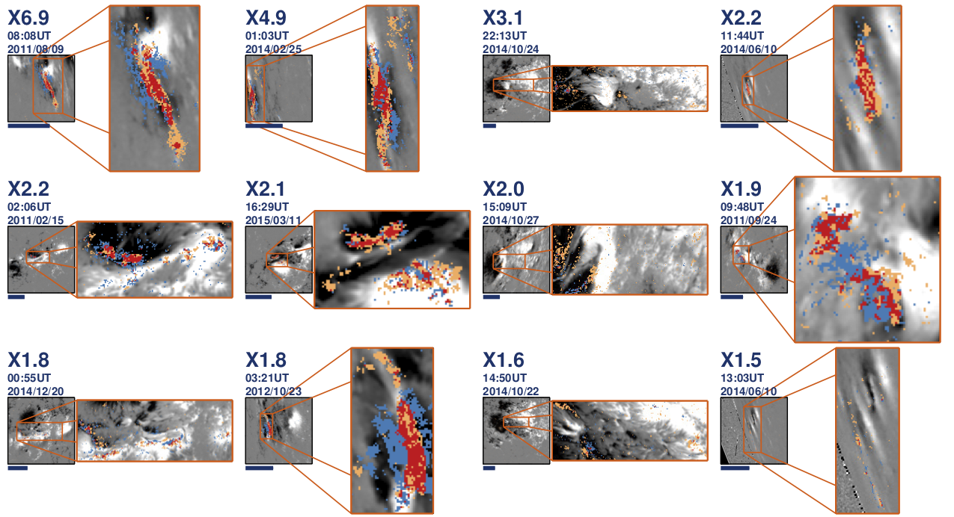
Continuum emission, also called white-light emission (WLE), and permanent changes of the magnetic field (ΔBLOS) are often observed during solar flares. However, their relation and precise mechanisms are still unknown. We study statistically the relationship between ΔBLOS and WLE during 75 solar flares of different strengths and locations on the solar disk. We analyze SDO/HMI data and determine for each pixel in each flare if it exhibited WLE and/or ΔBLOS. We then investigate the occurrence, strength, and spatial size of the WLE, its dependence on flare energy, and its correlation to the occurrence of ΔBLOS. We detected WLE in 44/75 flares and ΔBLOS in 59/75 flares. We find that WLE and ΔBLOS are related, and their locations often overlap between 0% and 60%. Not all locations coincide, thus potentially indicating differences in their origin. We find that the WL area is related to the flare class by a power law, and extend the findings of previous studies, that the WLE is related to the flare class by a power law, to also be valid for C-class flares. To compare unresolved (Sun-as-a-star) WL measurements with our data, we derive a method to calculate temperatures and areas of such data under the blackbody assumption. The calculated unresolved WLE areas improve, but still differ to the resolved flaring area by about a factor of 5–10 (previously 10–20), which could be explained by various physical or instrumental causes. This method could also be applied to stellar flares to determine their temperatures and areas independently.

Slide 4
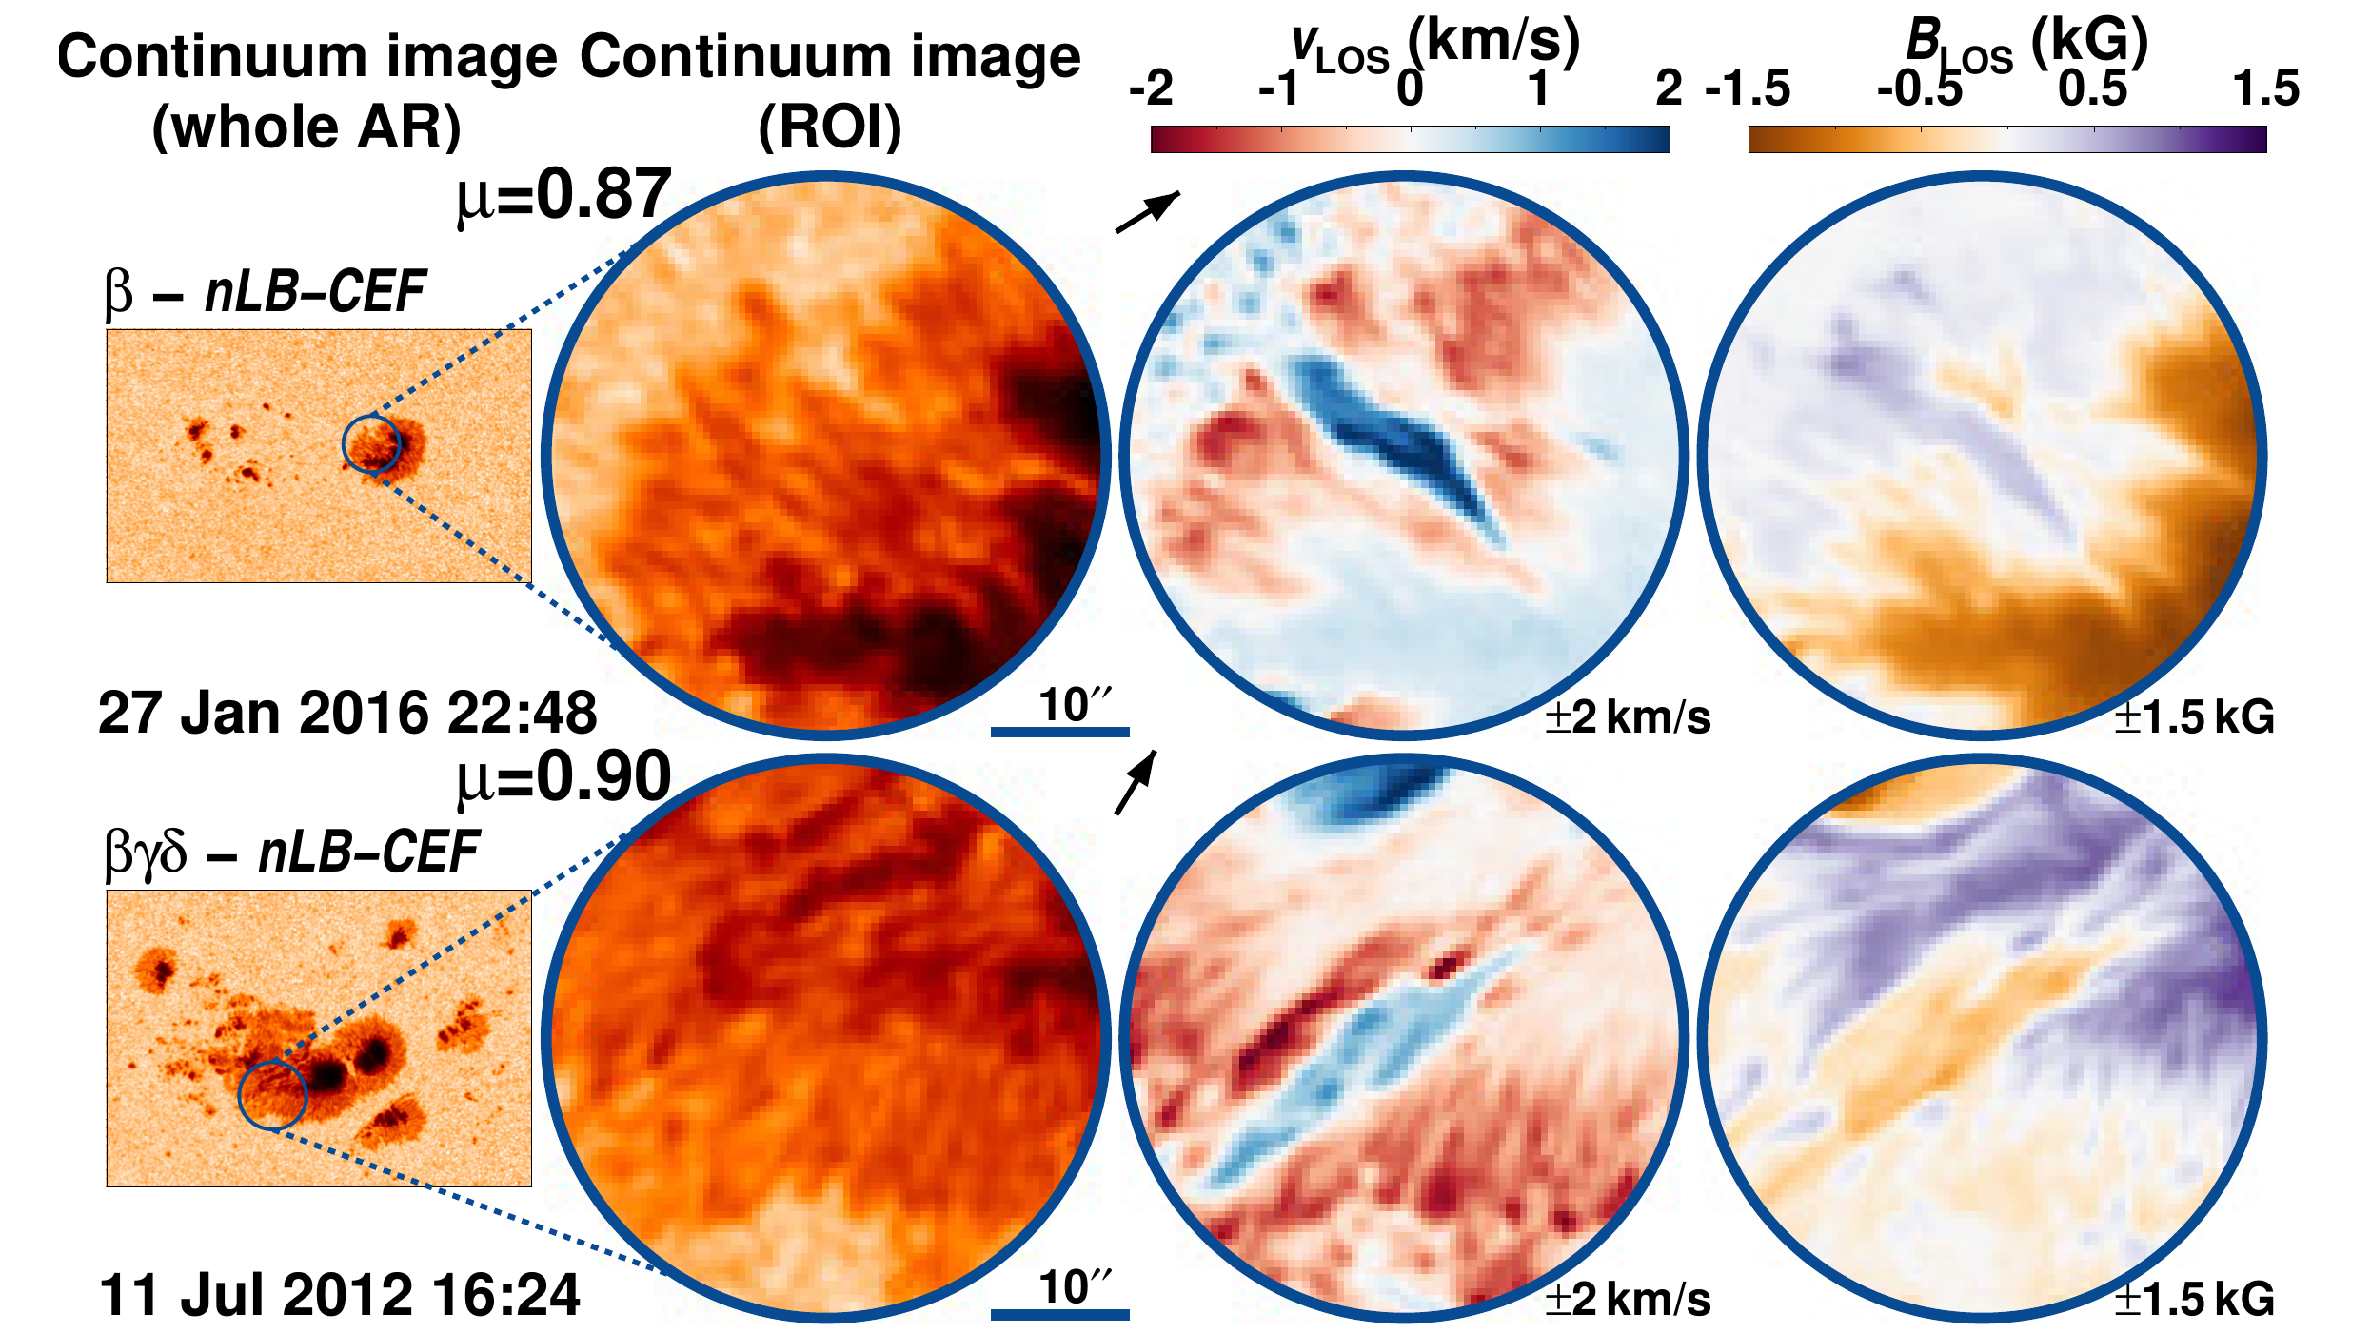

One of the main characteristics of sunspot penumbrae is the radially outward-directed Evershed flow. Only recently have penumbral regions been reported with similar characteristics to normal penumbral filaments but with an opposite direction of the flow. Such flows directed toward the umbra are known as counter Evershed flows (CEFs). We aim to determine the occurrence frequency of CEFs in active regions (ARs) and to characterize their lifetime and the prevailing conditions in the ARs. We analyzed the continuum images, Dopplergrams, and magnetograms recorded by SDO/HMI of 97 ARs that appeared from 2011 to 2017. We followed the ARs for 9.6$±$1.4 days on average. We found 384 CEFs in total, with a median value of six CEFs per AR. Counter Evershed flows are a rather common feature, occurring in 83.5% of all ARs regardless of the magnetic complexity of the AR. However, CEFs were only observed, on average, during 5.9% of the mean total duration of all the observations analyzed here. The lifetime of CEFs follows a log-normal distribution with a median value of ${10.6}_{−6.0}^{12.4}$ h. In addition, we report two populations of CEFs, those that are associated with light bridges and those that are not. We explain that the rarity of reports of CEFs in the literature is a result of highly incomplete coverage of ARs with spectropolarimetric data. By using the continuous observations now routinely available from space, we are able to overcome this limitation.

Slide 5
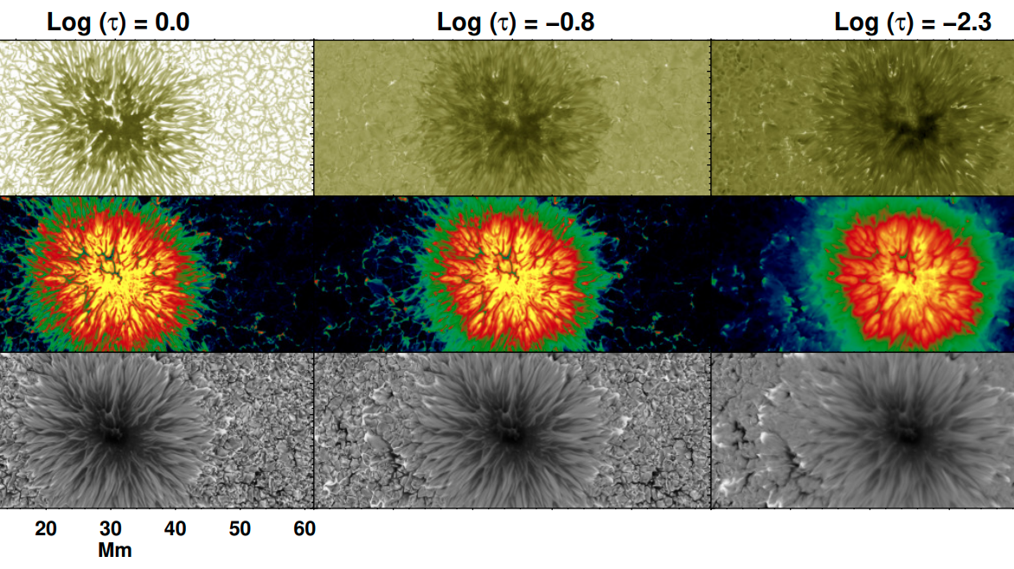
Context. The sunspot umbra harbors the coolest plasma on the solar surface due to the presence of strong magnetic fields. The routinely used atomic lines to observe the photosphere have weak signals in the umbra and are often swamped by molecular lines. This makes it harder to infer the properties of the umbra, especially in the darkest regions.
Aims. The lines of the Ti I multiplet at 2.2μm are formed mainly at temperatures ≤ 4500 K and are not known to be affected by molecular blends in sunspots. Since the first systematic observations in the 1990’s, these lines have been seldom observed due to the instrumental challenges involved at these longer wavelengths. We revisit these lines and investigate their formation in different solar features.
Methods. We synthesize the Ti I multiplet using a snapshot from 3D MHD simulation of a sunspot and explore the properties of two of its lines in comparison with two commonly used iron lines at 6302.5 Å and 1.5648 μm.
Results. We find that the Ti I lines have stronger signals than the Fe I lines in both intensity and polarization in the sunspot umbra and in penumbral spines. They have little to no signal in the penumbral filaments and the quiet Sun, at μ=1. Their strong and well-split profiles in the dark umbra are less affected by stray light. Consequently, inside the sunspot it is easier to invert these lines and to infer the atmospheric properties, compared to the iron lines.
Conclusions. The Cryo-NIRSP instrument at the DKIST will provide the first ever high-resolution observations in this wavelength range. In this preparatory study, we demonstrate the unique temperature and magnetic sensitivities of the Ti multiplet, by probing the Sun’s coolest regions which are not favourable for the formation of other commonly used spectral lines. We thus expect such observations to advance our understanding of sunspot properties

Slide 6
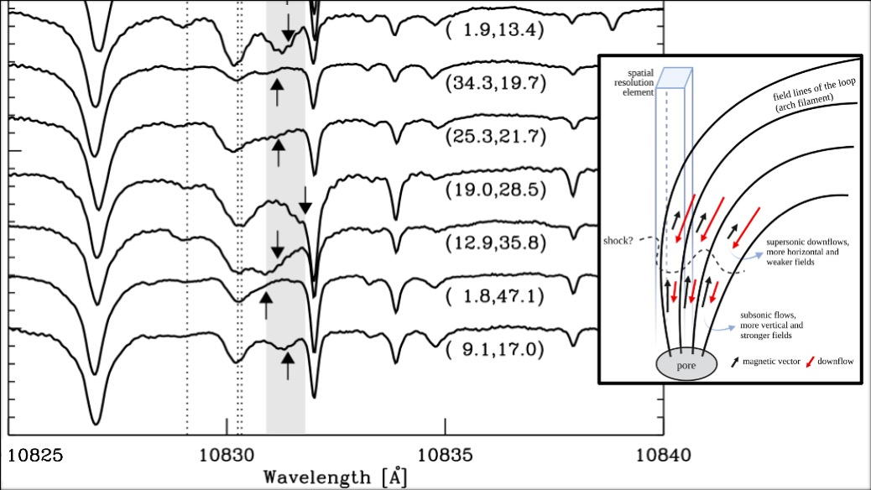
The chromosphere above active regions (ARs) on the Sun hosts magnetized supersonic downflows. Studies of these supersonic downflows help to decipher the magnetic fine structure and dynamics of the chromosphere. We perform a statistical analysis of the magnetized supersonic downflows in a number of ARs and survey their characteristics. We analyze spectro-polarimetric scans of parts of 13 ARs obtained in the infrared He I 10830 Å triplet formed in the upper chromosphere recorded with the GREGOR Infrared Spectrograph (GRIS) mounted at the GREGOR solar telescope. We retrieve the line-of-sight velocities and the magnetic field vector using the HeLIx+ inversion code that assumes Milne-Eddington atmospheres. We find magnetized supersonic downflows in all the ARs, with larger area coverage by such flows in ARs observed during their emerging phase. The fact that supersonic downflows were detected in all scans, though they cover only a small fraction, 0.2-6.4%, of the observed field-of-view, suggests that they are a common phenomenon in the upper chromospheres of ARs. The supersonic downflows are found to be associated with many AR features such as pores, sunspot umbrae, sunspot penumbrae, light bridges, plages, He I loops as part of arch filament systems characteristic of emerging fields, and filaments. Although several mechanisms are identified to be causing the supersonic downflows, by far the most common one appears to be the draining of plasma along the legs of rising magnetic loops. The loops mainly drain into forming pores. The line-of-sight velocities of the supersonic downflows reach up to 49 km s⁻¹ and the velocity distribution shows multiple populations. Almost 92% of these supersonic downflows coexist with a subsonic flow component. The weaker, more horizontal fields associated with the supersonic component suggests that it is formed above the subsonic component.

Slide 7
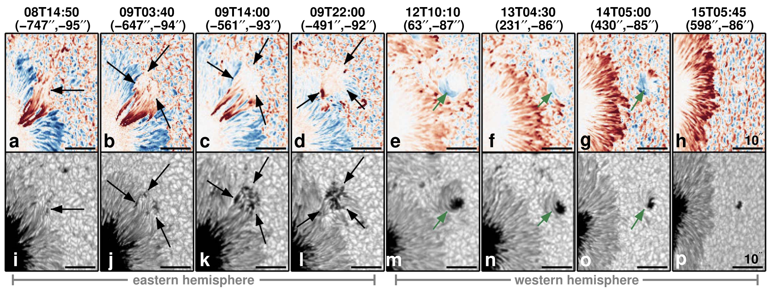
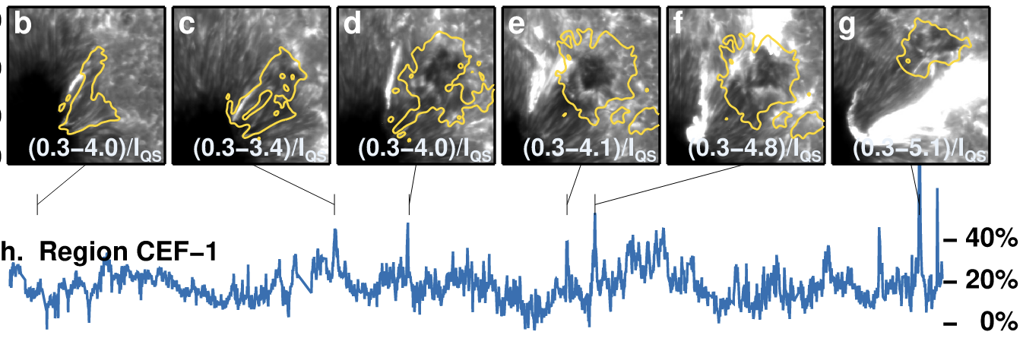
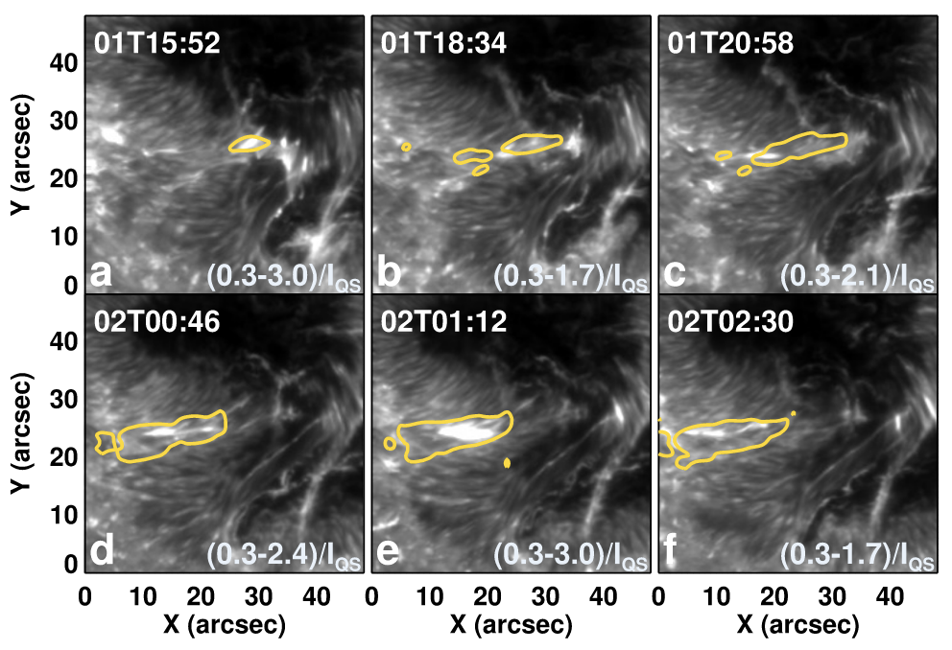
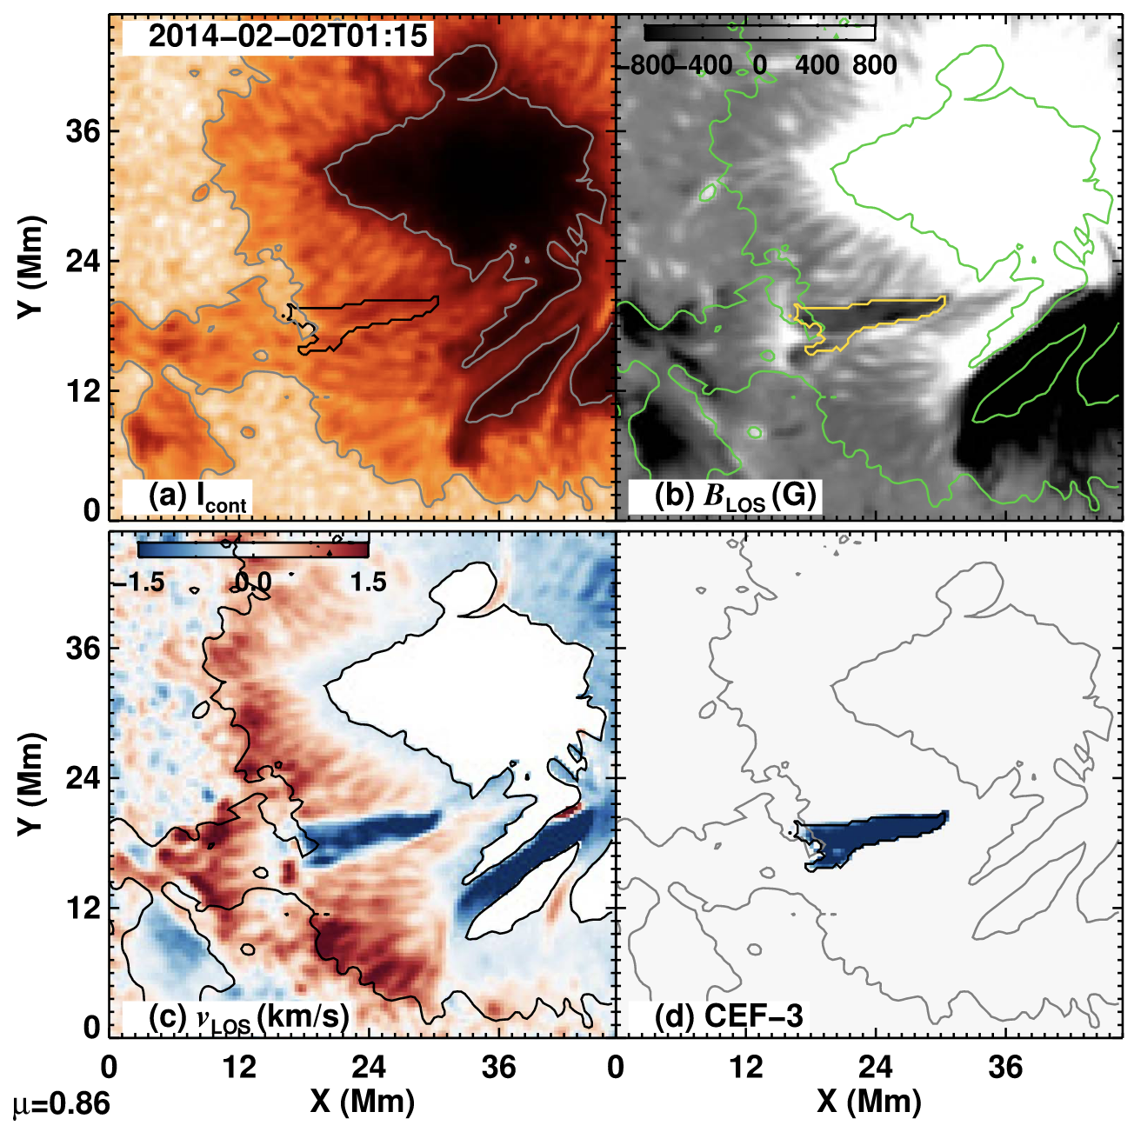
In addition to the Evershed flow directed from the umbra toward the outer boundary of a sunspot, under special circumstances a counter Evershed flow (CEF) in the opposite direction also occurs. We aim to characterize the proper motions and evolution of three CEFs observed by the Solar Optical Telescope on board the Japanese Hinode spacecraft and the Helioseismic and Magnetic Imager on board the Solar Dynamics Observatory. We use state-of-the-art inversions of the radiative-transfer equation of polarized light applied to spectropolarimetric observations of the Fe I line pair around 630 nm. The three CEFs appeared within the penumbra. Two of the CEF structures, as part of their decay process, were found to move radially outwards through the penumbra parallel to the penumbral filaments with speeds, deduced from their proper motions, ranging between 65 and 117 m s−1. In these two cases, a new spot appeared in the moat of the main sunspot after the CEFs reached the outer part of the penumbra. Meanwhile, the CEFs moved away from the umbra, and their magnetic field strengths decreased. The expulsion of these two CEFs seems to be related to the normal Evershed flow. The third CEF appeared to be dragged by the rotation of a satellite spot. Chromospheric brightenings were found to be associated with the CEFs, and those CEFs that reached the umbra–penumbra boundary showed enhanced chromospheric activity. The two CEFs, for which line-of-sight velocity maps were available during their formation phase, appear as intrusions into the penumbra. They may be associated with magnetic flux emergence.

